Slide 1


BDAT 1011- Data Analytics Project
Predictive Analysis For Sales and Inventory Management

Slide 2



Agenda
Introduction of the Team
About the project
Tasks and Challenges
Review of the process
Closure

Slide 3



Team
Sindhu
Nihitha
Varun
Team Lead
Data Analyst
Developer

Slide 4




Project Summary
The aim of the project is to do a predictive analysis of the future sales of the superstore data which is available from 2014-2017 and give an estimation so that the management can manage their inventory effectively.

Slide 5

Tasks and Challenges
Finding Dataset
Understanding and Cleaning the data
Visualizing the data
Regression Analysis
Predicting the Future Sales

Slide 6
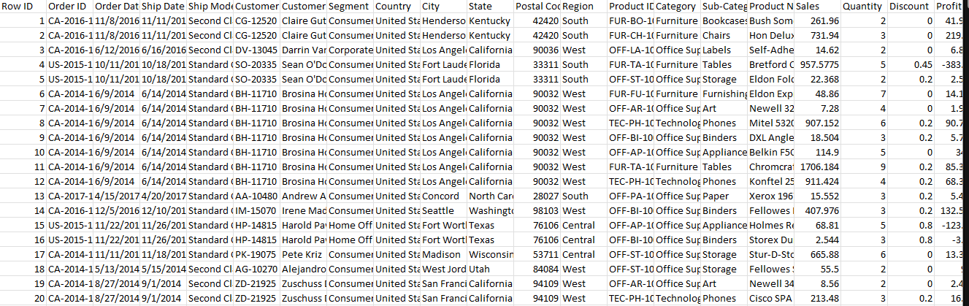
Finding Data Set
We found our dataset in Kaggle @ Sample Superstore Dataset | Kaggle
Sample of the data set

Slide 7
Understanding and Cleaning the data
After finalizing the dataset, we cleaned the data and selected parameters to work on.
While cleaning the data we came across some columns which will not be of much use so removed columns Country, Row ID and Ship Date from the Raw data
Formatted Order date to summarize data year wise the data we came across some columns
Made sure that there are no blanks and duplicates are present in the data

Slide 8

Visualizing the data
Visualized the parameters by making graphs to understand the sales and profits in various states and their respective categories
We did our visualization using PowerBI and Tableau
With the knowledge acquired through the visualizations we achieved our goal to do a predictive analysis on the future sales and profit.

Slide 9
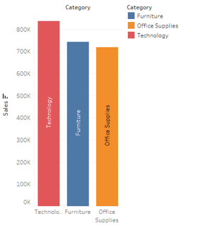
Goods related to Technology have highest sales

Slide 10
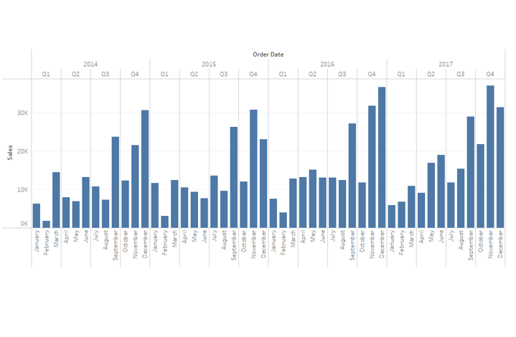
Furniture goods sales per month

Slide 11
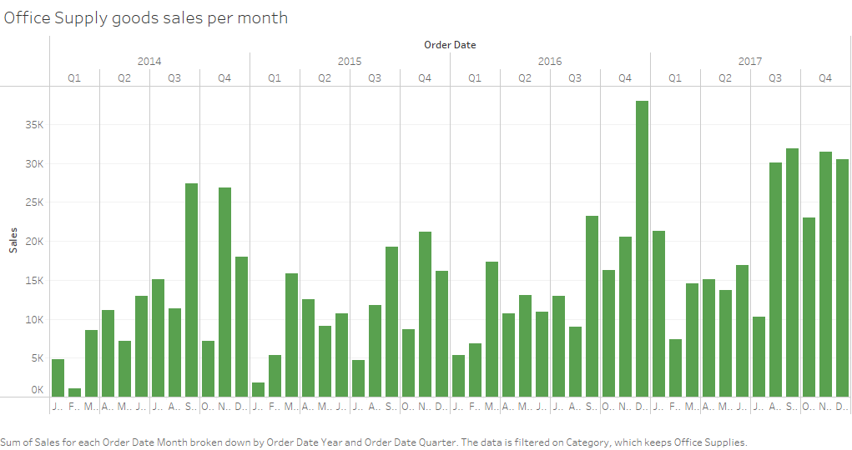
Office Supply goods sales per month

Slide 12
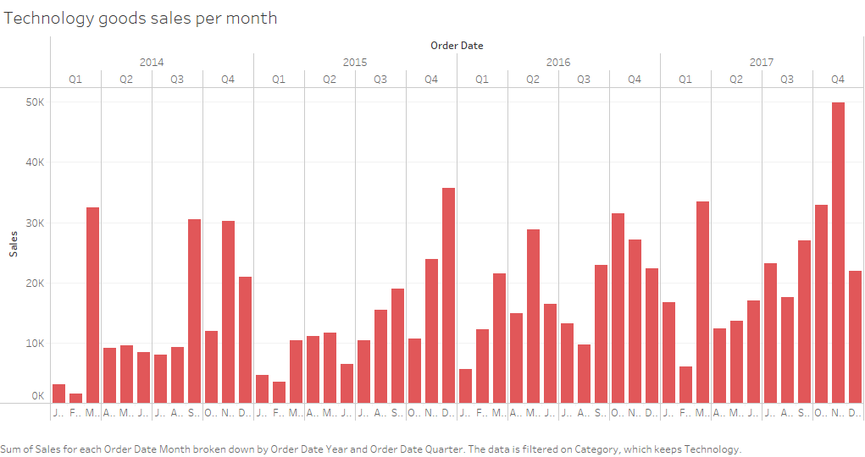
Technology goods sales per month

Slide 13
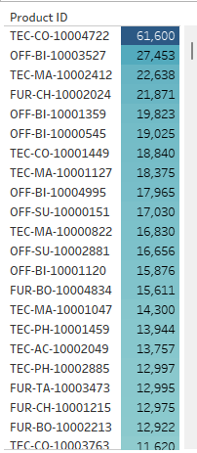
Sales Per Product

Slide 14
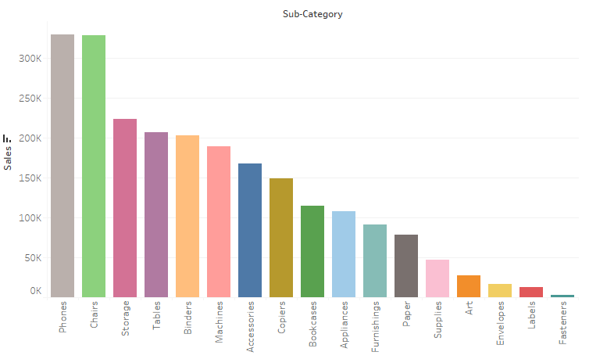
Sales Per Sub-Category

Slide 15
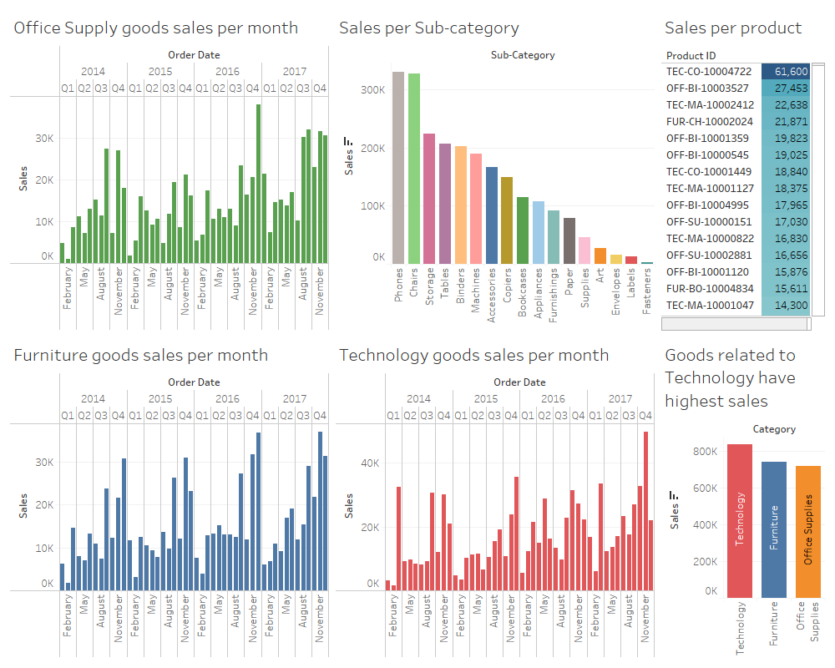
Dashboard

Slide 16

Sales and Sales by State
Sales $0M $0.46M
$0.5M
Power BI Desktop
$0.4M
$0.3M
Sales
$0.2M
$0.1M
$0.0M
Texas
Florida
Illinois
Ohio
Virginia
Indiana
Georgia
Arizona
Missouri
Alabama
Oregon
Nevada
Arkansas
Utah
Vermont
Montana
Iowa
Idaho
Kansas
Maine
Michigan
Kentucky
Colorado
Delaware
Louisiana
New York
Maryland
Nebraska
California
Wisconsin
Tennessee
Oklahoma
Wyoming
Washington
New Jersey
Minnesota
Connecticut
Mississippi
New Mexico
Pennsylvania
Rhode Island
West Virginia
North Carolina
Massachusetts
South Carolina
New Hampshire
District of Columbia
South Dakota
North Dakota
State

Slide 17
Sales and Profit by Sub-Category
Sales Profit
Phones Chairs Storage Tables Binders Machines
Accessories
Copiers Bookcases Appliances Furnishings
Paper Supplies
Art Envelopes
Labels Fasteners
Power BI Desktop
Sub-Category
$0.0M
$0.1M
Sales and Profit
$0.2M
$0.3M

Slide 18
Sales and Profit by Segment
Sales Profit
$1.2M
Power BI Desktop
$1.0M
$0.8M
Sales and Profit
$0.6M
$0.4M
$0.2M
$0.0M
Consumer
Corporate
Segment
Home Office

Slide 19
Sales, Profit and Profit by Year
Sales Profit Profit
$0.8M
Power BI Desktop
$100K
$0.6M
$80K
Sales and Profit
$0.4M
Profit
$60K
$0.2M
$0.0M
2014
2015
2016
2017
$40K
Year

Slide 20
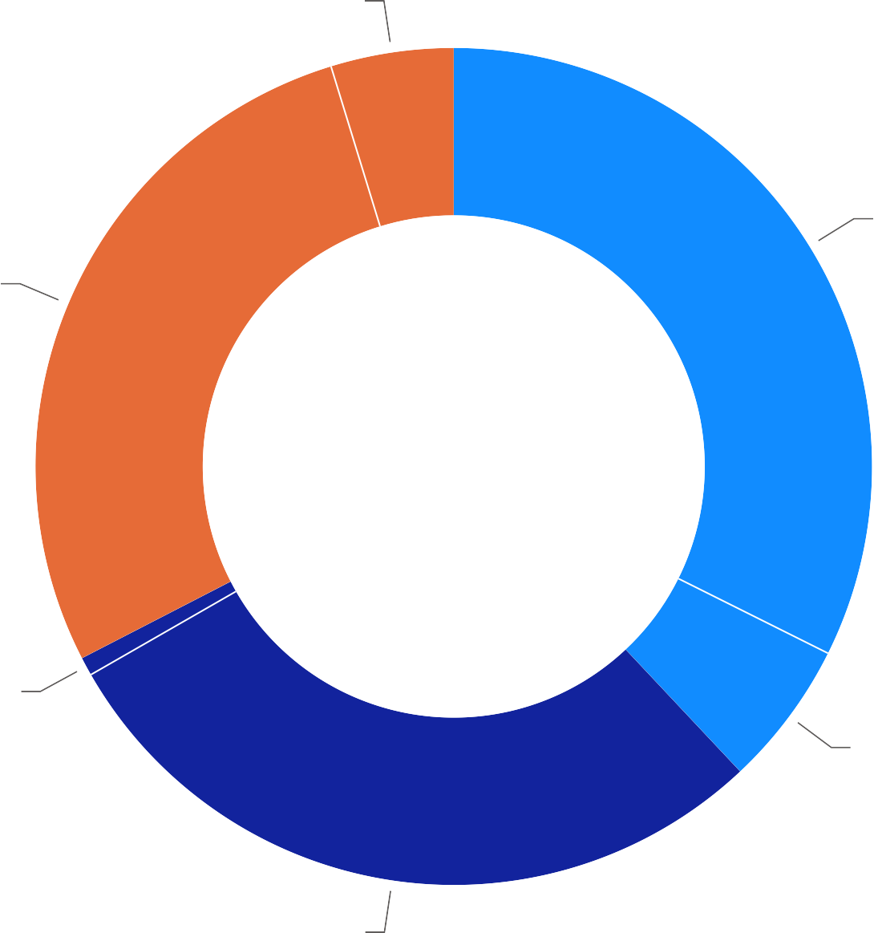
Sales and Profit by Category
Power BI Desktop
$122.49K (4.74%)
$836.15K (32.36%)
$719.05K (27.83%)
Category
Technology
Furniture Office Supplies
$18.45K (0.71%)
$145.45K (5.63%)
$742K (28.72%)

Slide 21
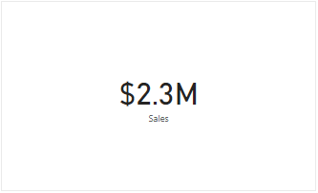
Client KPI
Overall Sales

Slide 22
Observations
Goods Related to Technology have highest sales followed by furniture goods.
California and New york have the highest sales and they might need an inventory back up.
The sales of Furniture are increasing every month and there is the sale of tables is giving highest profit to the store than any other product which they can work on and improve their marketing.

Slide 23
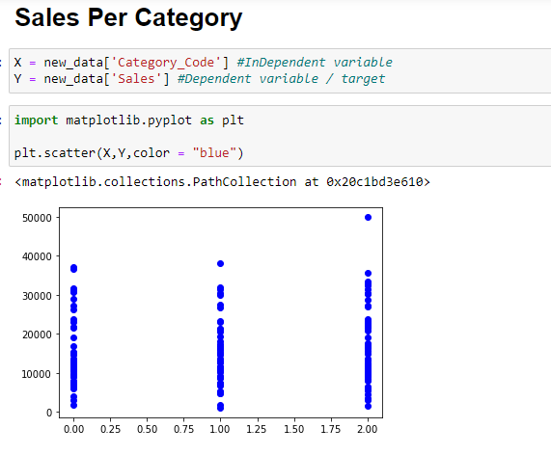

Slide 24
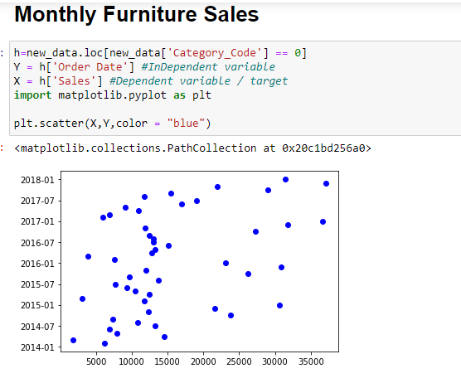

Slide 25
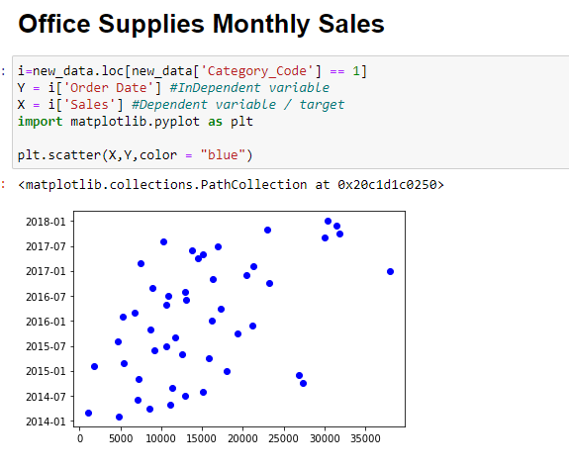

Slide 26
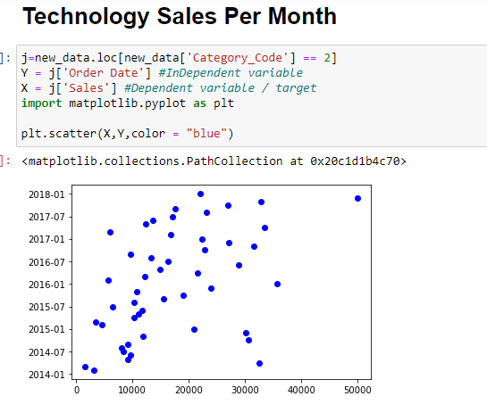

Slide 27
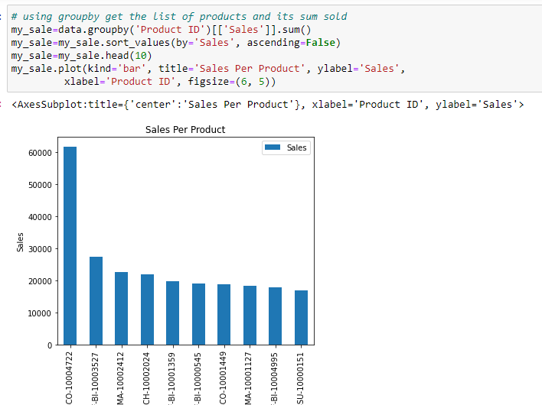

Slide 28
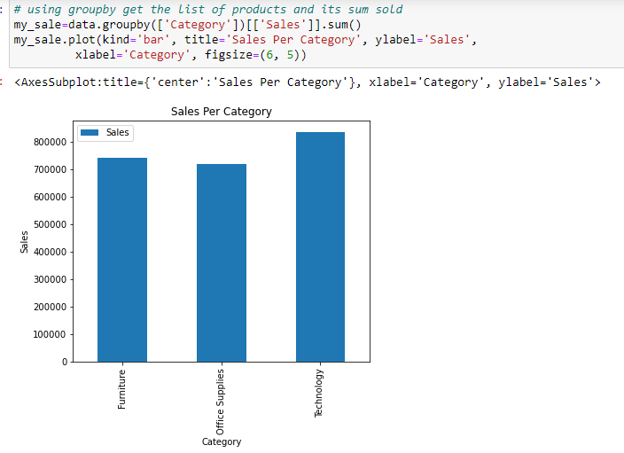

Slide 29
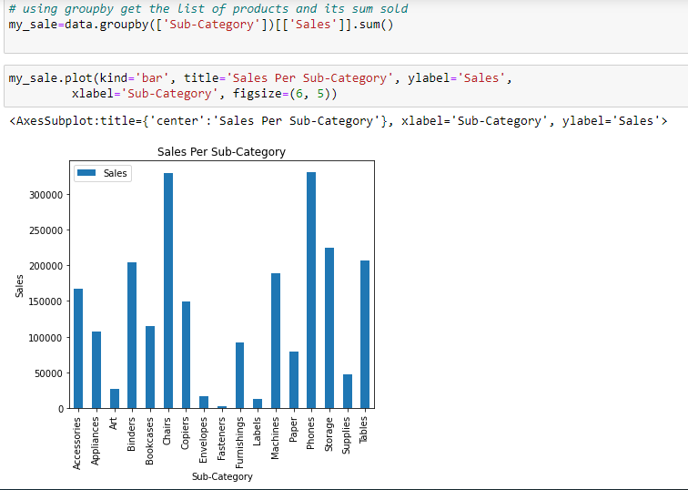

Slide 30

We could see that the sales related to technology are high compared to other categories and we could also see that the furniture goods are also having relatively high sales. When compared Furniture goods also occupy lot of space
Conclusion

Slide 31
Communication Plan
Name | Role | Send/Receive Email | Weekly Meetings | Decisions | Documentation
Client Name | Stakeholder | Yes | Attend | Project Scope | Project documentation
Diego Carbajal | Instructor | Yes | Optional Attendee | Progression of Project | Grading
Project Manager Name | Project Manager | Yes | Suggested Attendee | Project and Task Management related items | Project Management Presentation components
Sindhu Chakravaram | Team Lead | Yes | Attend, Book, Minutes, Agenda | Team, Project and Own Tasks | Communication, Development
Varun Sikka | Developer | Yes | Attend | Own Tasks | Predictive Analysis
Nihitha Patcha | Data Analyst | Yes | Attend | Own Tasks | Analysis of Data

Slide 32


Thank You

